Slide 1

SRM INSTITUTE OF SCIENCE AND TECHNOLOGY
FACULTY OF ENGINEERING AND TECHNOLOGY
DEPARTMENT OF NETWORKING AND COMMUNICATIONS
18CSC101J- MINI PROJECT
BUS RESERVATION SYSTEMA
M.Sudharshan Reddy
(RA2111026010130)
Aswith Kumar
(RA2111026010129)
Lingeshwaran
(RA2111026010128)
Section: T1 Batch -2
Lab Instructor Name: Shobhana

Slide 2
INTRODUCTION
Online Bus Ticket Reservation System is a Web based application that works within a centralized network. This project presents a review on the software program “Online Bus Ticket Reservation System” as should be used in a bus transportation system, a facility which is used to reserve seats, cancellation of reservation and different types of route enquiries used on securing quick reservations. OBTRS is built for managing and computerizing the traditional database, ticket booking and tracking bus and travel made. It maintains all customer details, bus details, reservation details. In order to achieve the design, Imo Transport Company (ITC) was chosen as a case study because of its strategic importance to Imo State. Structured Systems Analysis and Design Methodology (SSADM) was adopted. In addition, PHP Hypertext Preprocessor (PHP) language was used for the front- end of the software while the back end was designed using MySQL. The software achieved is capable of improving the customer hand and relationship management in ITC operations. It is recommended that despite the present functionality of the designed software, an additional functionality such as the use of E-mail to send tickets and notifications to the customer and an online payment using credit cards/debit cards should be implemented into the system. Furthermore, other operations carried by ITC such as the courier services should also be integrated in order to enhance the system.

Slide 3
OBJECTIVES:
The main purpose of this study is to automate the manual procedures of reserving a bus ticket for any journey made through Imo Transport Company (ITC). This system is said to be an automatic system and customers can select seats by themselves. Specifically, objectives of this project will consist of:
i) Providing a web-based bus ticket reservation function where a customer can buy bus ticket through the online system without a need to queue up at the counter to purchase a bus ticket.
ii) Enabling customers to check the availability and types of busses online. Customer can check the time departure for every ITC bus through the system.
iii) Easing bus ticket payment by obtaining a bank pin after payments is made to the various designated banks.
iv) Ability of customers to cancel their reservation. v) Admin user privileges in updating and canceling payment, route and vehicle records.

Slide 4
Algorithm:
1.Start the Program
2.Print welcome
3.Read the key from user
4.Print the Main menu
5.Read the input from user of his choice
6.If 1
7. Read the input of Name and Number of Seats
8.Display the buses available
9.Read for confirmation
10.Display Details and print Reservation successful
11.Goto main menu
13.If 2
12.Display bus details
13.Goto main menu
14.If 3
15.Exit from portal

Slide 5
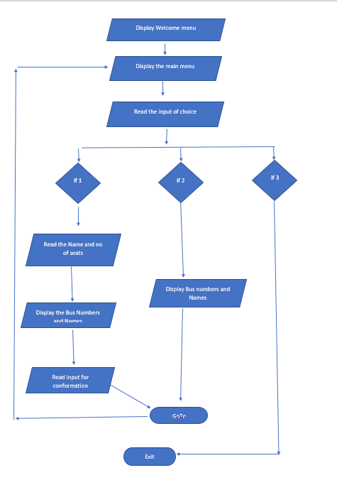
Flow Chart

Slide 6
Results and Discussion
In 1974, American airlines were the first to use an automated booking system, which was still almost manual. Technology grew, and a computer reservation system was developed. In this present era, online booking or reservation system has improved the operations of various sectors of a nation’s economy deploying this system. Online Bus Ticket Reservation System being a web based system that ensures that the company would be able to transform most of the processes carried out manually into automated, error-free and easy to use operations in the organization especially in the area of transportation; also it would be able to generate report for the management decision purpose. This system will be developed using a waterfall methodology for research and design purposes, PHP as the programming language because of its server-side processing capabilities that makes data process less on the client personal computer, an implementation strategy as well as testing and maintenance strategies suitable for efficient deployment of the system.

Slide 7
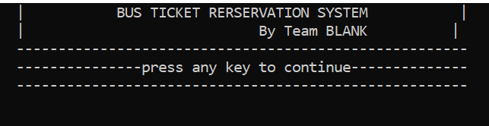
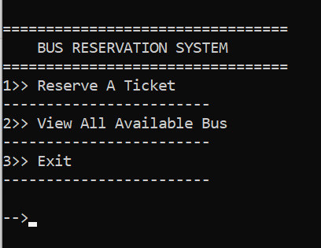
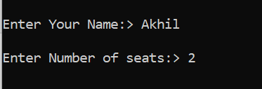
Snapshots of the result

Slide 8
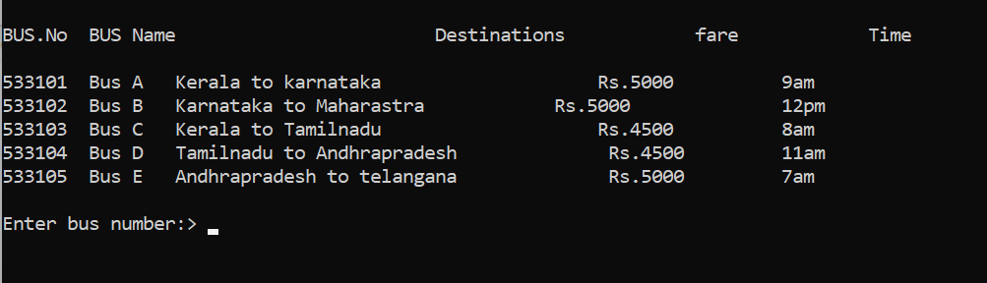
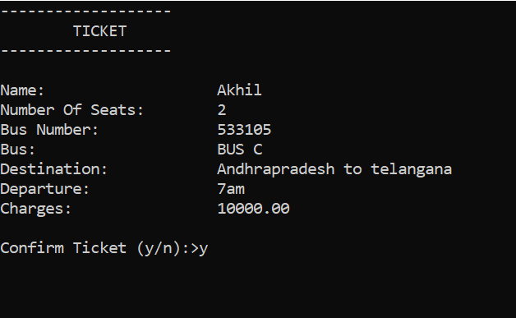

Slide 9
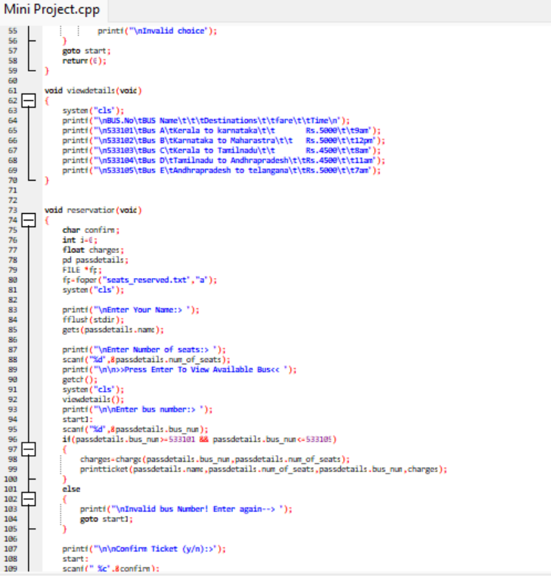
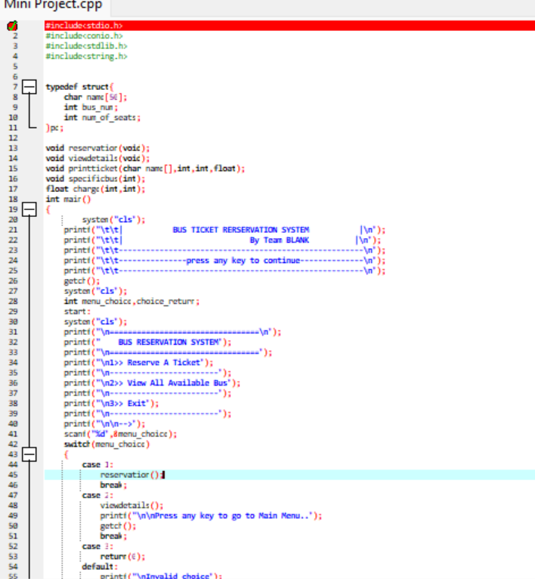
Sample Coding:

Slide 10
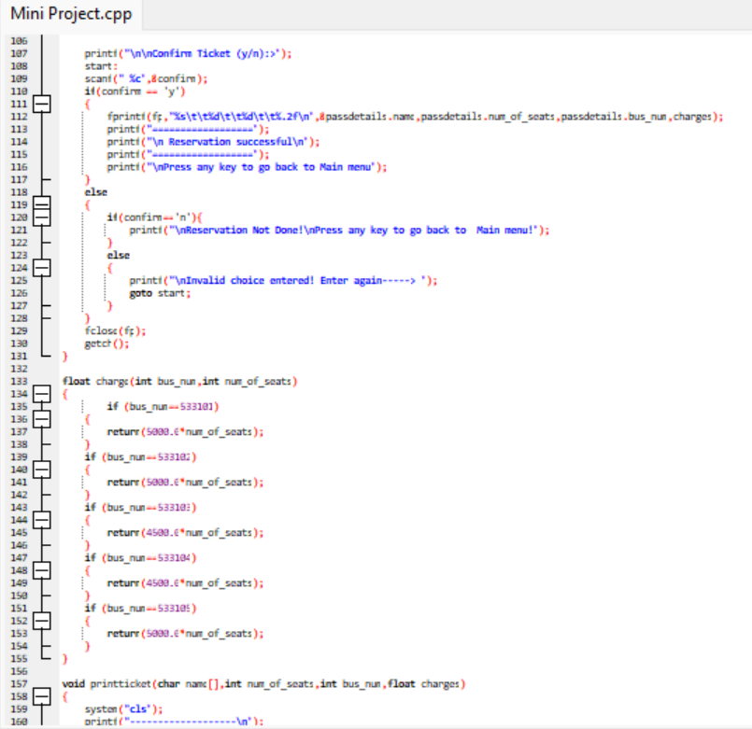
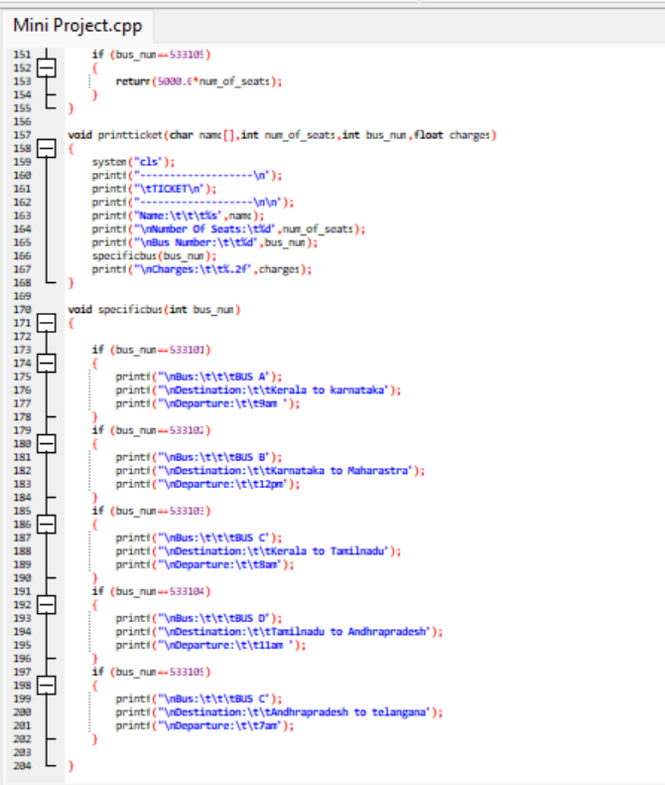

Slide 11
References
Madden A .D., (2000): "A definition of information", Aslib Proceedings, Vol. 52 Iss: 9, pp.343 – 349
Flick, U. (2009): An Introduction to Qualitative Research. London: SAGE Hevner A., March S., Park J., and Ram, S. (2004): Design Science in Information Systems Research. MIS Quarterly.
Kevin O. C., (2012): Web-Based Bus Reservation and Ticketing System: College of Computer Studies, Ateneo de Naga University, Naga City, Philippines February 26, 2012 Lawes,(2010): "Central Reservation System | Online Hotel Marketing Services, Hong Kong and Philippines Hotel, Spa and Restaurant Software". Iaweb.net. 2010. Retrieved 2012-11-08.

Slide 12
Thanks

